Slide 2
Frame
Creates a standard window that has a title bar, resize corners, and a menu bar.
Frame( )
Frame(String title)
void setSize(int newWidth, int newHeight)
void setSize(Dimension newSize)
void setVisible(boolean visibleFlag)
void setTitle(String newTitle)

Slide 3
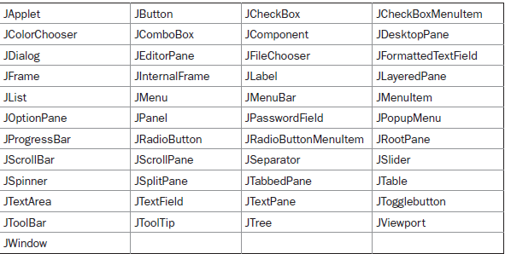
Swing components are derived from the JComponent class
javax.swing.

Slide 4
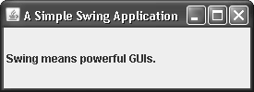
JFrame is the top-level container that is commonly used for Swing applications.
JFrame jfrm = new JFrame("A Simple Swing Application");
Void setSize(int width, int height)
jfrm.add(jlab);
JLabel jlab = new JLabel(" Swing means powerful GUIs.");

Slide 5
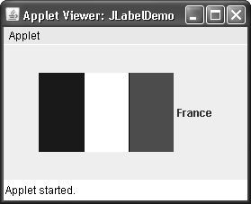
JLabel can be used to display text and/or an icon.
JLabel(Icon icon)
JLabel(String str)
JLabel(String str, Icon icon, int align)

Slide 6
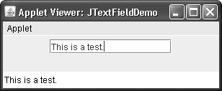
JTextField allows you to edit one line of text.
JTextField(int cols)
JTextField(String str, int cols)
JTextField(String str)

Slide 7
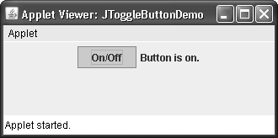
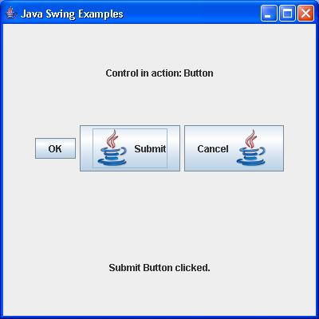

Slide 8
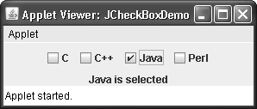

Slide 9
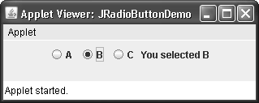

Slide 10
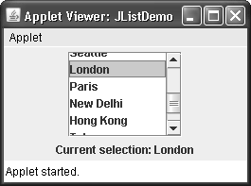
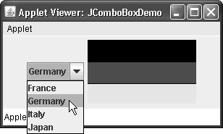

Slide 11
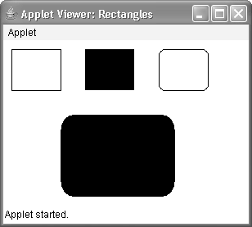

Slide 12
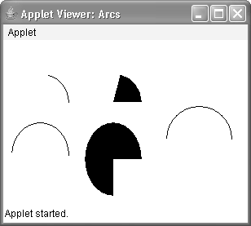

Slide 13
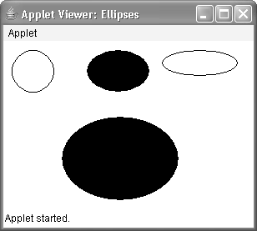

Slide 14
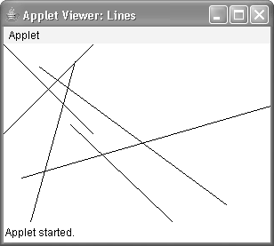

Slide 15
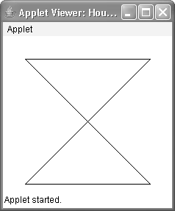

Slide 16
FlowLayout is the default layout manager. This is the layout manager that the preceding examples have used. FlowLayout implements a simple layout style, which is similar to how words flow in a text editor. Here are the constructors for
FlowLayout:
FlowLayout( )
FlowLayout(int how)
FlowLayout(int how, int horz, int vert)
FlowLayout.LEFT
FlowLayout.CENTER
FlowLayout.RIGHT
FlowLayout.LEADING
FlowLayout.TRAILING

Slide 17
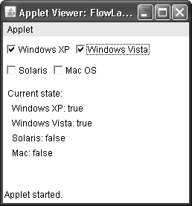

Slide 18
The BorderLayout class implements a common layout style for top-level windows.
The four sides are referred to as north, south, east, and west. The middle area is called the center. Here are the constructors defined by BorderLayout:
BorderLayout( )
BorderLayout(int horz, int vert)
The first form creates a default border layout. The second allows you to specify the horizontal and vertical space left between components in horz and vert, respectively.
BorderLayout defines the following constants that specify the regions:
BorderLayout.CENTER BorderLayout.SOUTH
BorderLayout.EAST BorderLayout.WEST
BorderLayout.NORTH
add( ), which is defined by Container:
void add(Component compObj, Object region)
Here, compObj is the component to be added, and region

Slide 19
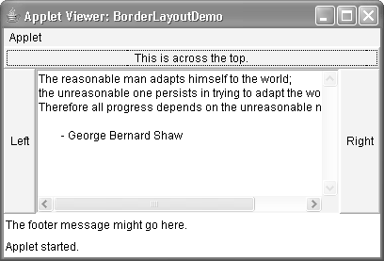

Slide 20
GridLayout lays out components in a two-dimensional grid.
When you instantiate a GridLayout, you define the number of rows and columns. The constructors supported by GridLayout are shown here:
GridLayout( )
GridLayout(int numRows, int numColumns)
GridLayout(int numRows, int numColumns, int horz, int vert)

Slide 21
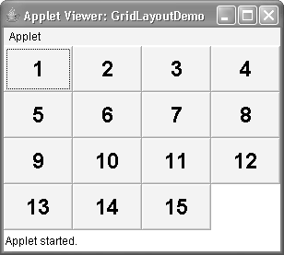

Slide 22
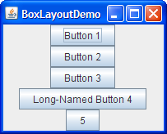
BoxLayout either stacks its components on top of each other or places them in a row

